Slide 1
GOVT. COLLEGE ROPAR
DEPARTMENT OF ECONOMICS
TOPIC-: PRICE DETERMINATION UNDER PERFECT COMPITITION
PERFECT COMPITITION.
FEATURES.
THREE PERIODS.
CONCLUSION.
PROF. RITU CLASS –B.A. 1 sSEM 2

Slide 2
Perfect Competition
Perfect competition is defined as a market situation where there are a large number of sellers of a homogeneous product. An individual firm supplies a very small portion of the total output and is not powerful enough to exert an influence on the market price.
A single buyer, however large, is not in a position to influence the market price. Market price in a perfectly competitive market is determined by the interaction of the forces of market demand and market supply. Market demand means the sum of the quantity demanded by individual buyers at different prices

Slide 3
Features of perfect competition
Many Buyers and Sellers –
There will always be a huge number of buyers and sellers in this form of marketplace. The advantage of having a large number of small-sized producers is that they cannot combine to influence the market price. If the quantity offered by an individual seller is very small compared to the total market produce, they cannot influence the market price independently.
Homogeneity –
The product or service produced by the buyers in a perfectly competitive market should be homogenous in all respects. There should be no differentiation between them in terms of quantity, size, taste, etc., so that the products are perfect substitutes for each other. If a seller tries to charge a higher price for products that are so similar, they will lose their customers immediately.

Slide 4
A
Free Entry and Exit –
Another condition of a perfectly competitive market is that no artificial restrictions prevent a firm’s entry, or compel an existing firm to stay put when they want to leave. Their decision to enter, stay or leave the market depends purely on economic factors.
Perfect Knowledge –
The buyers and sellers have perfect knowledge about the market conditions. The buyers are aware of the details of the product sold as well as its price. At the same time, the sellers know about the potential sales of their products at different price points. Since the buyers are already informed about the product, there is no need for advertising or sales promotion. So firms don’t have to invest a single penny in these activities. It also helps sellers save on advertising or other marketing activities, which keeps the price of their product s low

Slide 5
Price determination under perfect competition is analyzed under three different time periods :
Market Period
(b) Short Run
(c) Long Run
(a) Market Period: In a market period, the time span is so short that no firm can increase its output. The total stock of the commodity in the market is limited. The market period may be an hour, a day or a few days or even a few weeks depending upon the nature of the product.
For example, in the case of perishable commodities like vegetables, fish, eggs, the period may be a day. Since the supply of perishable commodities is limited by the quantity available or stock in day that neither can be increased nor can be withdrawn for the next period, the whole of it must be sold away on the same day, whatever may be the price.

Slide 6
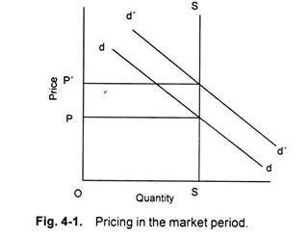
The supply curve of perishable commodities like fish is perfectly inelastic and assumes the form of a vertical straight line SS. Let us suppose that the demand curve for fish is given by dd. Demand curve and supply curve intersect each other at point R, determining the price OP. If the demand for fish increases suddenly, shifting the demand curve upwards to d’d .

Slide 7
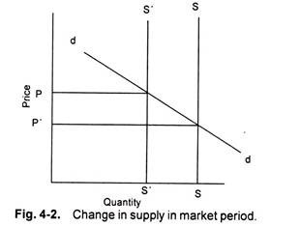
The equilibrium point shift from R to R” and the price rises to OP’. In this situation, price is determined solely by the demand condition that is an active agent.

Slide 8
Similarly, if the demand for a product is given, as shown in demand curve SS in figure. If the supply of the product decreases suddenly
from SS to S’S’, the price increases from P to P’. In this case price is determined by supply, the supply being an active agent.
In this case supply curve shifts leftward causing increase in price of the reduced supply goods. Given the demand curve dd and supply curve SS, the price is determined at OP. Demand curve remaining the same, the decrease in supply shifts the supply curve to its left to S’S’. Consequently, the price rises from OP to OP’.
The supply curve of non-perishable but reproducible goods will not be a vertical straight line throughout its length. This is for certain goods can be withdrawn from the market if the price is too low as the seller would not sell any amount of the commodity in the present market period and would like to hold back the whole stock

Slide 9
PRICE IN THE SHORT RUN – EQUILIBRIUM OF THE FIRM:
Short period is the span of time so short that existing plants cannot be extended and new plants cannot be erected to meet increased demand. However, the time is adequate enough for producers to adjust to some extent their output to the increase in demand by overworking their fixed capacity plants. In the short run, therefore, supply curve is elastic.
The average and marginal cost curves of the firm together with its demand curve. Demand curve, in a perfectly competitive market, is also the average revenue curve and the marginal revenue curve of the firm. The marginal cost intersects the average cost at its minimum point. The U-shape of both the cost curves reflects the law of variable proportions operative in the short run during which the size of the plant remains fixed

Slide 10
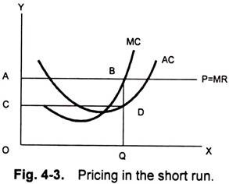
The firm is in equilibrium at the point B where the marginal cost curve intersects the marginal revenue curve from below:

Slide 11
LONG RUN
The long run is a period of time long enough to permit changes in the variable as well as in the fixed factors. In the long run, accordingly, all factors are variable and non- fixed. Thus, in the long run, firms can change their output by increasing their fixed equipment. They can enlarge the old plants or replace them by new plants or add new plants.
Moreover, in the long run, new firms can also enter the industry. On the contrary, if the situation so demands, in the long run, firms can diminish their fixed equipment by allowing them to wear out without replacement and the existing firm can leave the industry.
Thus, the conditions for long run equilibrium of perfectly competitive firm can be written as:
Price = Marginal Cost = Minimum Average Cost

Slide 12
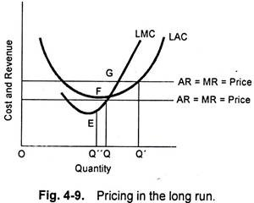
The conditions for the long run equilibrium of the firm under perfect competition can be easily understood from the Fig. 4.9, where LAC is the long run average cost curve and LMC in the long run marginal cost curve. The firm under perfect competition cannot be in long run equilibrium at price OP’, because though the price OP’ equals MC at G (i.e., at output OQ) but it is greater than the average cost at this output and, therefore, the firm will be earning supernormal profits

Slide 13
CONCLUSION
It follows that the equilibrium between demand and supply ,or what is often called market equilibrium determine the price in the market . Price comes to settle in the market at the level where demand and supply curves intersect each other

